Slide 1
COMP 2710 Software Construction
Software Process – Class Diagram
Dr. Xiao Qin
Auburn University
http://www.eng.auburn.edu/~xqin
xqin@auburn.edu
Spring, 2012

Slide 2
Three Main Steps in the Design Phase
1. Construct Data Flow Diagram
Object Names
Functions
2. Construct Initial Class Diagram
3. Construct Sequence Diagram
4. Construct Final Class Diagram
Objects
4. Testing

Slide 3
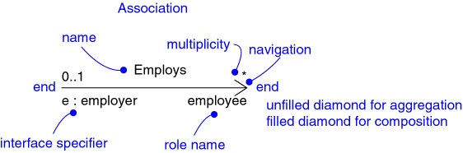
Relationships
Association
  Aggregation
  Composition
Inheritance
Notes:
Don’t cover the details of the graphic on this slide. The semantics of each of the relationships will be discussed later.

Slide 4
Relationships: Association
Models a semantic connection among classes
Association Name
Professor
Works for
University
Association
Role Names
Class
Professor
University
Employee
Employer
Notes:
Associations connect instances of two or more classes together for some duration (as opposed to a dependency relationship, which represents a temporary association between two instances).
Dependency relationships will be discussed in the Class Design module.
Do not use relationship/role names if they add no value/information to the model. Remember, readability and understandability of the model are key -- only add information that adds value, not clutter to the diagrams.

Slide 5
Example: Single Inheritance
One class inherits from another
Ancestor
Account
balance
Superclass (parent)
name
number
Withdraw()
CreateStatement()
Generalization Relationship
Checking
Savings
Subclasses
Withdraw()
GetInterest()
Withdraw()
Descendents

Slide 6
Example: Multiple Inheritance
A class can inherit from several other classes
FlyingThing
Animal
multiple
inheritance
Airplane
Helicopter
Bird
Wolf
Horse
Use multiple inheritance only when needed, and
always with caution !

Slide 7
What Gets Inherited?
A subclass inherits its parent’s attributes, operations, and relationships
A subclass may:
  Add additional attributes, operations, relationships
  Redefine inherited operations (use caution!)
Common attributes, operations, and/or relationships are shown at the highest applicable level in the hierarchy
Inheritance leverages the similarities among classes
Copyright © 2008 Pearson Addison-Wesley. All rights reserved.
Notes:
Emphasize that when a change is made to a super class all descendent classes inherit the change.
Some languages do not support generalization. In these cases you will need to update the design model to reflect the characteristics of the implementation language. In cases where the implementation language does not support generalization between classes you must “design generalization in”. See the language specific appendices for more information. See Class Design for more information.

Slide 8
Example: What Gets Inherited
GroundVehicle
Person
Superclass (parent)
weight
owner
licenseNumber
0..*
1
register( )
generalization
Car
Truck
Trailer
Subclass
size
tonnage
getTax( )
Notes:
Ask the class the following to test their understanding:
“Without looking at your notes:
How many operations does Car have?
Answer: 1
How may relationships?
Answer: 1
How many operations does Truck have?
Answer: 2
How may relationships?
Answer: 2”
Generalization provides a way to implement polymorphism in cases where polymorphism is implemented the same way for a set of classes. The use of generalization to support polymorphism is discussed in more detail in the Class Design module

